Slide 1
Priority-driven Scheduling
Lecturer: BuiHa Duc, PhD
Department of Mechatronics

Slide 2
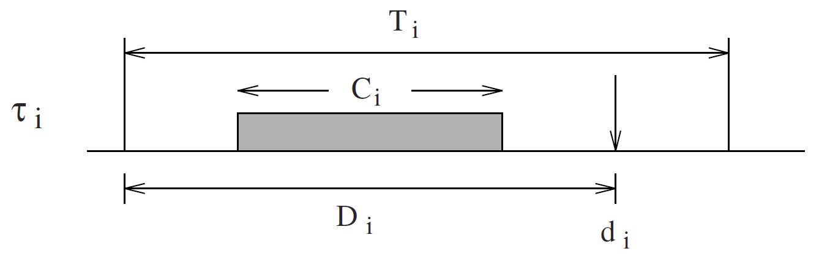
Deadline Monotonic Scheduling
DMS was first proposed in 1982 by Leung and Whitehead
DMS is an extension of RMS where task have relative deadline less than or equal to their period.
p_{i}

Slide 3
Deadline Monotonic Scheduling
DMS assigns task priority according to relative deadlines
  the shorter the relative deadline, the higher the priority
When relative deadline of every task matches its period, then rate monotonic and deadline monotonic give identical results
DMS can sometimes produce a feasible schedule in cases where rate monotonic cannot
RMS always fails when DMS fails
When deadline ≠ period, DMS is preferred

Slide 4
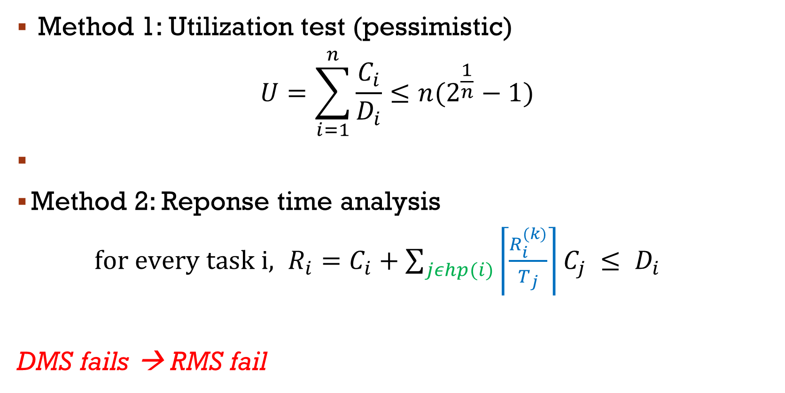
SCHEDULABILITY ANALYSIS
Method 1: Utilization test (pessimistic)
$$U=\sum_{i=1}^{n}{\frac{C_{i}}{D_{i}}≤n(2^{\frac{1}{n}}−1)}$$
Method 2: Reponse time analysis
$for every task i, R_{i}=C_{i}+\sum_{jεhp(i)}{\left\lceil \frac{R_{i}^{(k)}}{T_{j}}\right\rceil C_{j}} ≤ D_{i}$
DMS fails → RMS fail

Slide 5
Example
Exam the schedulability of these tasks
 | C_{i} | P_{i} | D_{i}
T₁ | 1 | 4 | 5
T₂ | 1 | 5 | 4
T₃ | 2 | 6 | 5
T₄ | 1 | 11 | 10

Slide 6
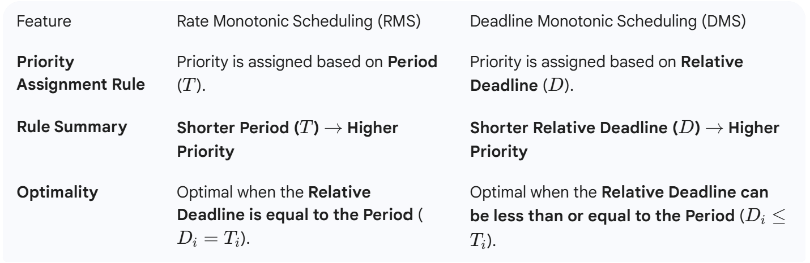
DMS vs RMS

Slide 7
Dynamic Priority Scheduling
Dynamic priority: priority of a task or job is not fixed but is calculated or adjusted at runtime
  Typically based on remaining time to deadline or slack time
Dynamic priority scheduling has higher utilization bound.
FreeRTOS is a fixed-priority, preemptive scheduler → does not implement dynamic priority scheduling by default.
  must calculate tasks’ priority periodically, then use vTaskPrioritySet() to manually update
  void vTaskPrioritySet( TaskHandle_t xTask, UBaseType_t uxNewPriority );

Slide 8
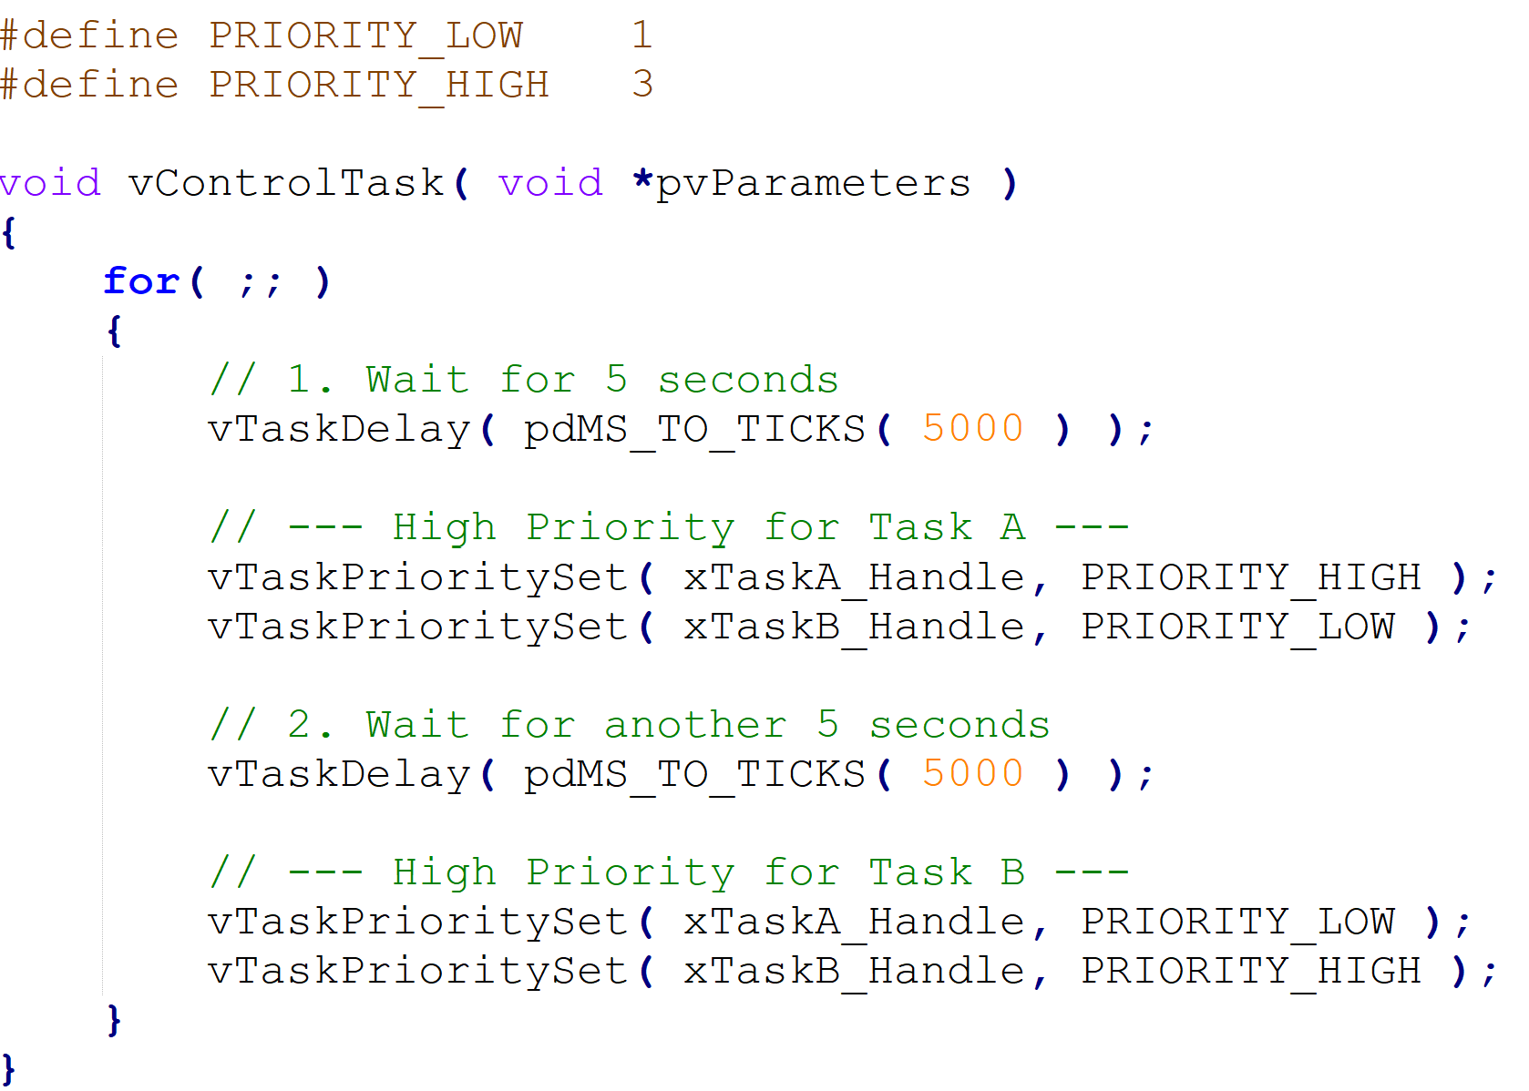

Slide 9
Dynamic-Priority Algorithms
Core Dynamic Priority Algorithms
Earliest deadline first (EDF)
  The job queue is ordered by earliest deadline
Least slack time first (LST)
  The job queue is ordered by least slack time
  Scheduling decisions made only when jobs release or complete
First in, first out (FIFO)
  Job queue is first-in-first-out by release time
Last in, first out (LIFO)
  Job queue is last-in-first-out by release time

Slide 10
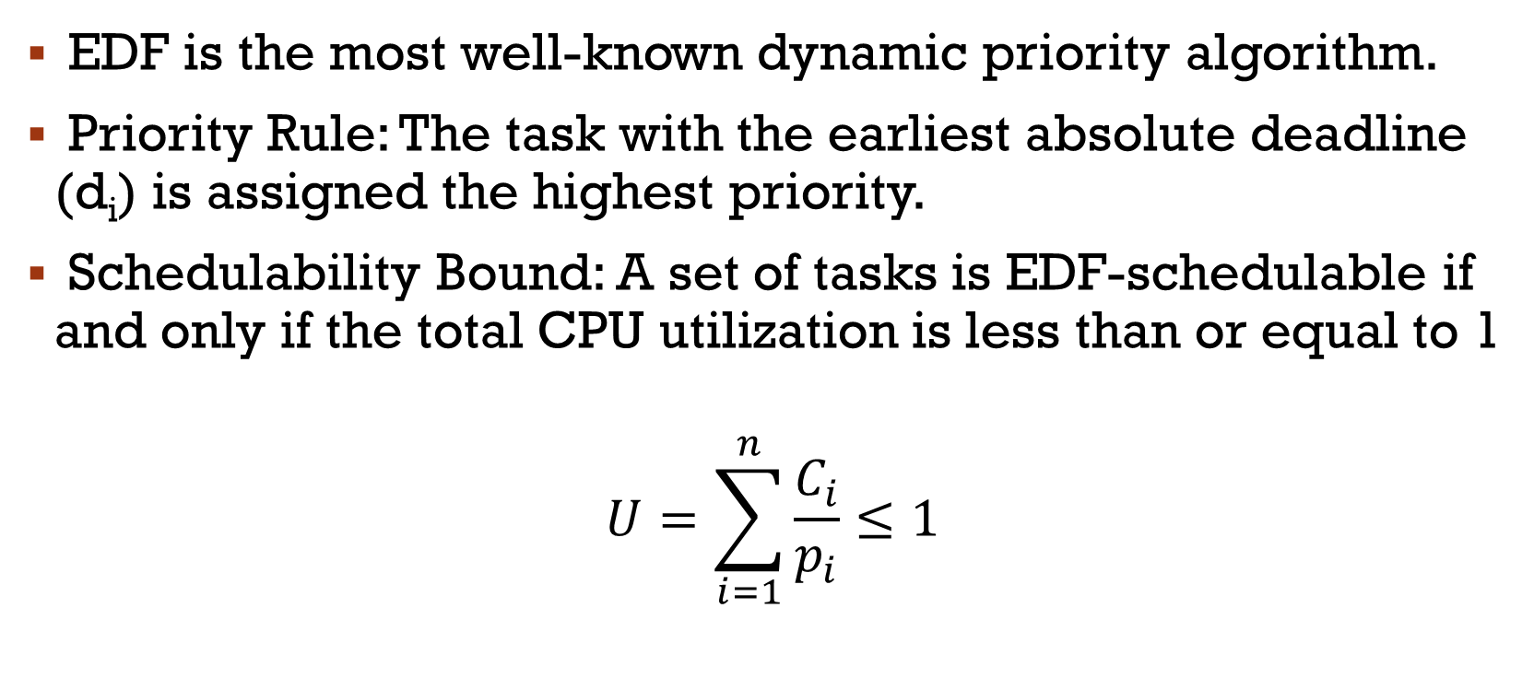
Earliest deadline first (EDF)
EDF is the most well-known dynamic priority algorithm.
Priority Rule: The task with the earliest absolute deadline (d_{i}) is assigned the highest priority.
Schedulability Bound: A set of tasks is EDF-schedulable if and only if the total CPU utilization is less than or equal to 1
$$U=\sum_{i=1}^{n}{\frac{C_{i}}{p_{i}}≤1}$$

Slide 11
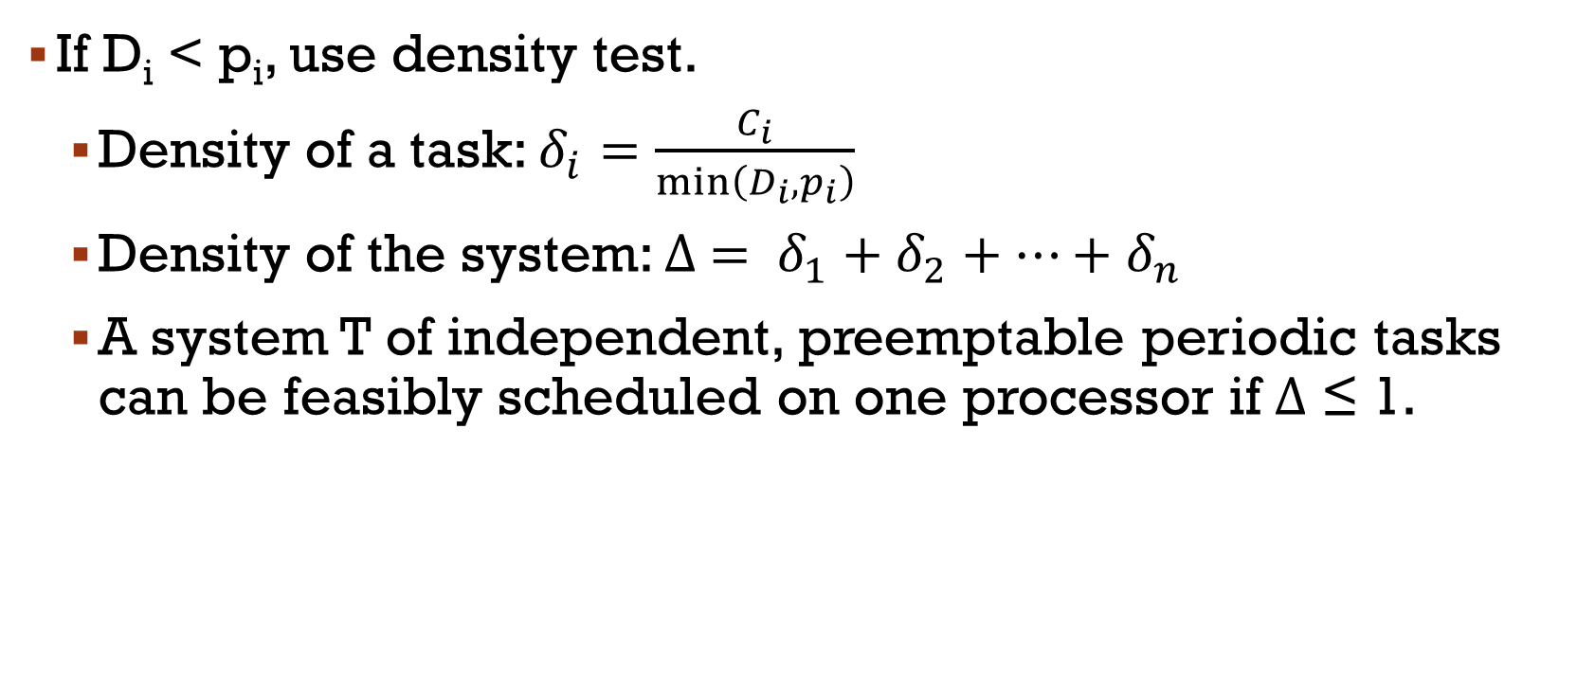
Schedulability Tests: EDF
If D_{i} < p_{i}, use density test.
  Density of a task: $δ_{i}=\frac{C_{i}}{\min\left(D_{i},p_{i}\right)}$
  Density of the system: $∆ = δ_{1}+δ_{2}+…+δ_{n}$
  A system T of independent, preemptable periodic tasks can be feasibly scheduled on one processor if Δ ≤ 1.

Slide 12
Least Slack Time First
LST is an algorithm under the same basic conditions as EDF
Priority rule: The task with the least slack time (or laxity) is assigned the highest priority
S_{i}(t) = (Absolute deadline – Current time) – Remain execution time
LST requires the scheduler to accurately track and update the remaining execution time for every task → significant runtime overhead and complexity
LST can suffer from a high number of context switches

Slide 13
Optimality of EDF and LST
On a single processor, as long as preemption is allowed and jobs do not contend for resources, EDF and LST are optimal
  they will always produce a feasible schedule if one exists
  if they fail to produce a feasible schedule, no feasible schedule exists
Neither algorithm is optimal if jobs are non-preemptable or if there is more than one processor

Slide 14
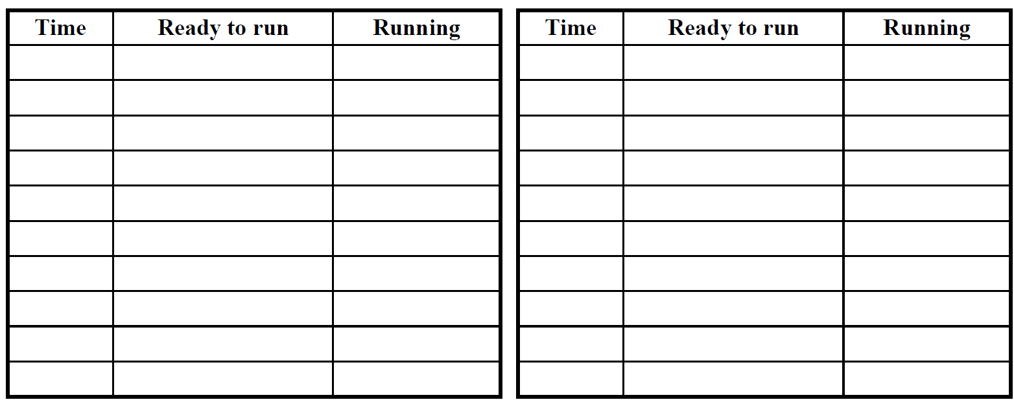
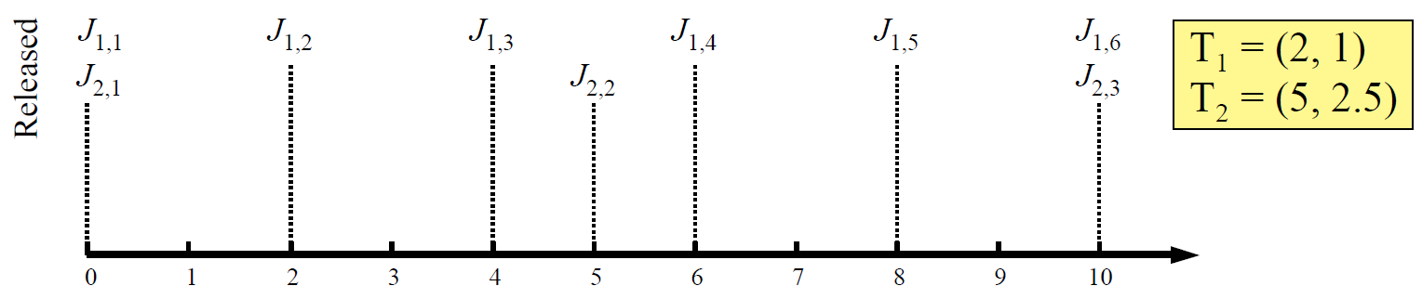
Example: Earliest Deadline First

Slide 15
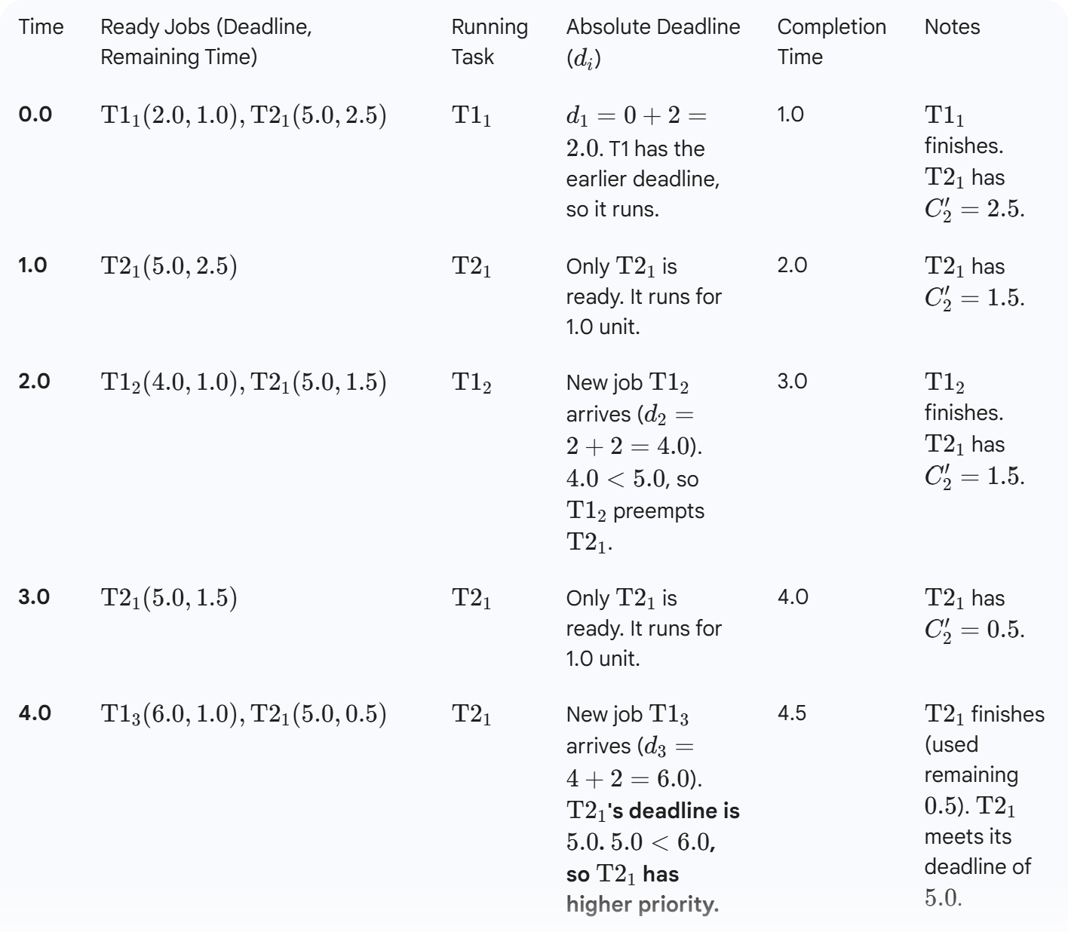

Slide 16
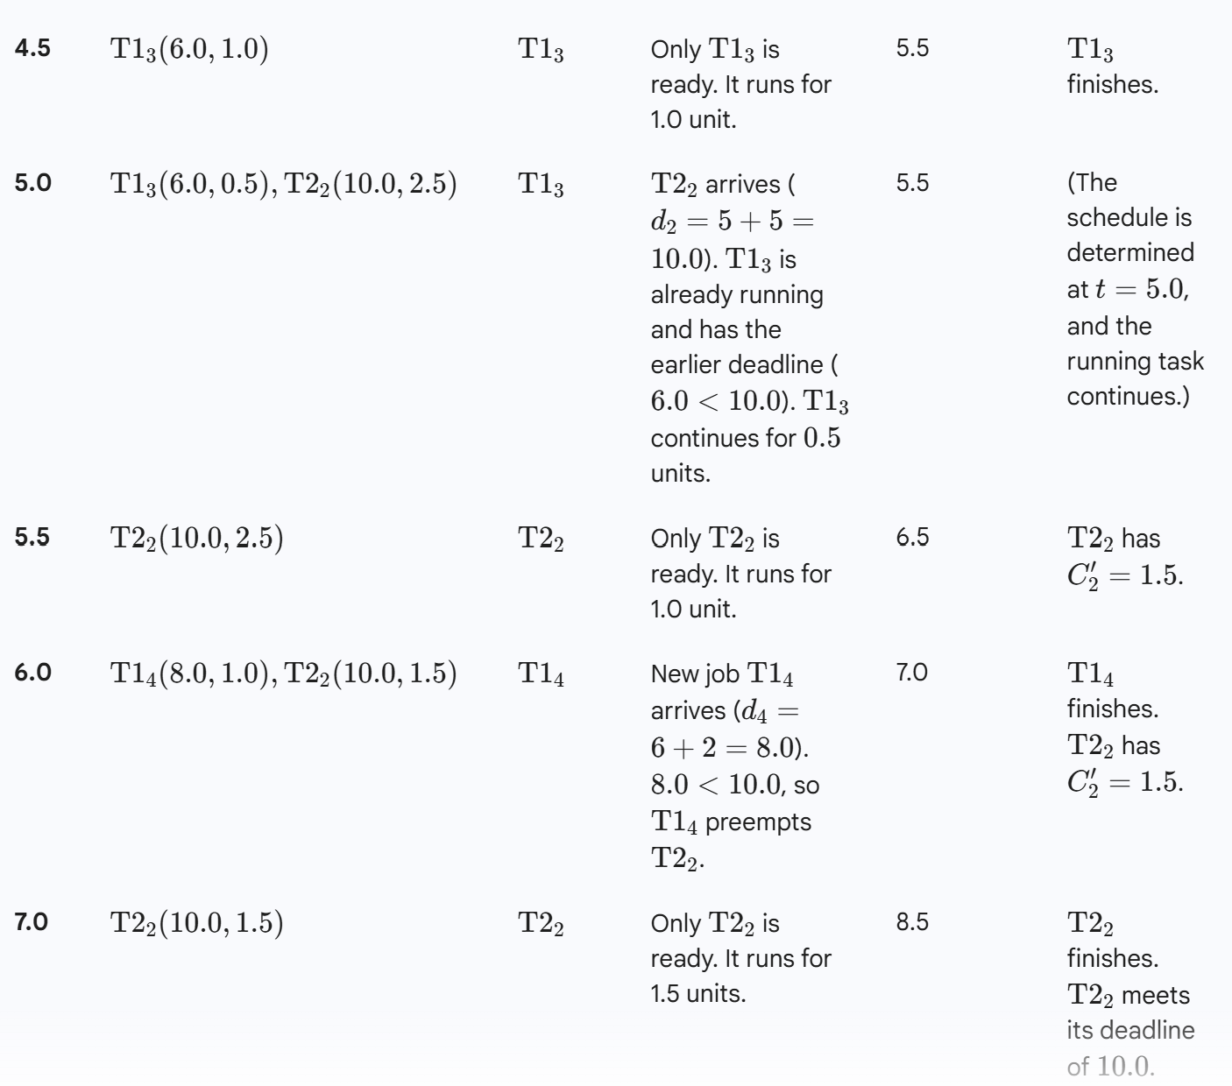

Slide 17
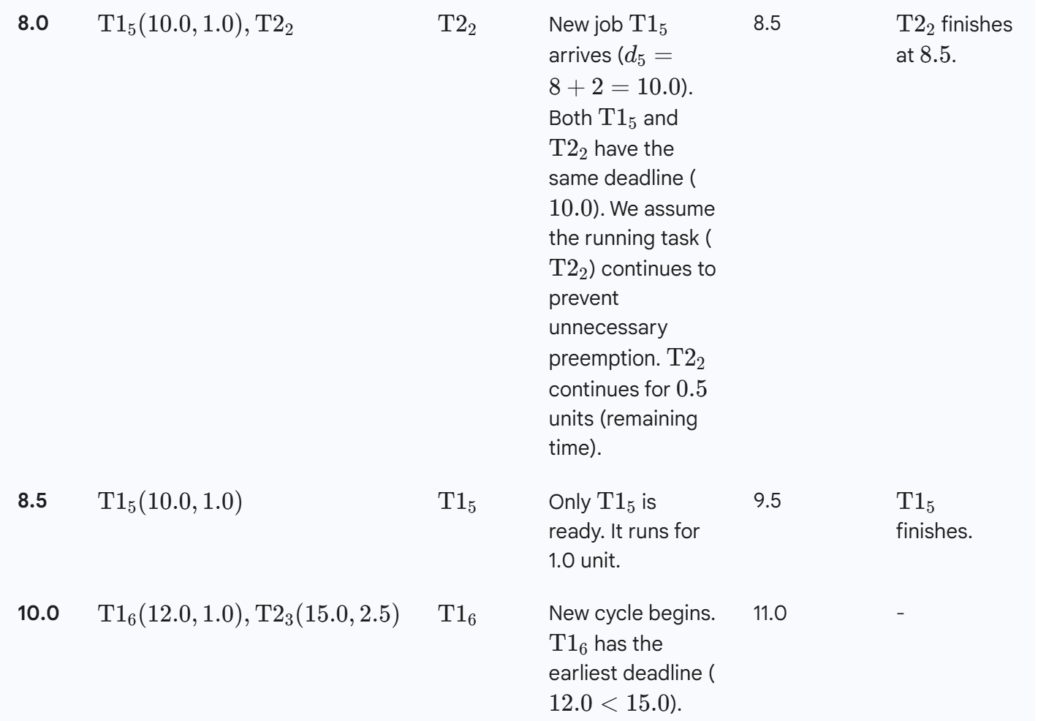

Slide 18
Practice considerations
Fixed- and dynamic-priority scheduling algorithms have different properties; neither appropriate for all scenarios
Algorithms that do not take into account the urgencies of jobs in priority assignment usually perform poorly (e.g FIFO, LIFO)
The EDF algorithm gives higher priority to jobs that have missed their deadlines than to jobs whose deadline is still in the future
Dynamic algorithms like EDF can produce feasible schedules in cases where RM and DM cannot
Fixed priority algorithms often more predictable, lower overhead

Slide 19
Example: Comparing Different Algorithms
Assume a single processor system with 2 tasks
T₁(2, 1)
T₂(5, 2.5)
Total utilization is 1 → no slack time
Try to schedule these tasks with RMS, EDF, LST, FIFO

Slide 20
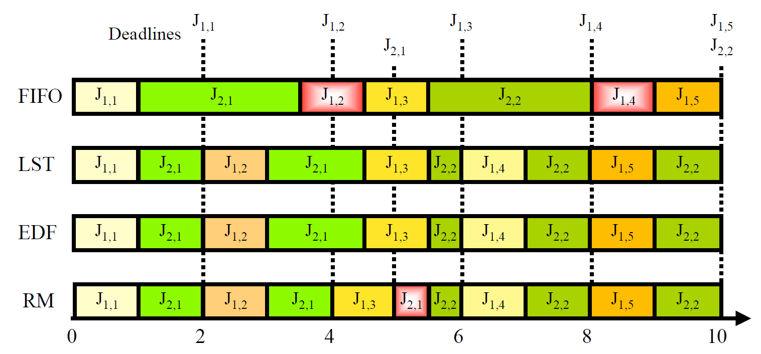
Example: Comparing Different Algorithms

